Slide 1


Improving retrieval algorithm on PBL ozone concentration by using OMI and machine learning: a case study in Atlanta and implications for TEMPO
Guanyu Huang¹, Chris Miller², Xiong Liu², Kelly Chance² ,Kang Sun³
1. Environmental & Health Sciences, Spelman College, Atlanta GA
2. Harvard-Smithsonian Center for Astrophysics, Cambridge, MA
3. SUNY- Buffalo, Buffalo, NY
2019 TEMPO Science Team Meeting
June 2019 Madison WI
ghuang@spelman.edu

Slide 2
Introduction
PBL ozone is the most concerning air pollution problem because of its direct threats to public health and agricultural production.
PBL ozone is also one of the most challenging problem for satellite observation:
  ~90% of the ozone is in the Stratosphere and 10% in the troposphere.
  The UV wavelengths for ozone retrievals can hardly reach the ground level.
New satellites (Geo: TEMPO, GEMS, Leo: TROPOMI, etc.) have better sensitivities to ozone in the PBL and lower troposphere.
Theses Sensitivities can be meaningful for surface AQ analysis. (Duncan et al. 2014, Flynn et al., 2015, Hyashida et al., 2018)

Slide 3
Introduction
PBL ozone is controlled by complex physical and chemical processes (NOx+ VOCs, MET , boundary layer dynamics, etc. ).
Previous studies indicated that the PBL ozone can be indirectly retrieved from values of ozone precursors on the ground level (Cheng et al., 2018, Zhang et al., 2018, Zoogman et al., 2014)
The goal of this study is to improve ozone retrieval algorithm on the PBL ozone by using OMI, MET data, etc. and machine learning technique (Random forest).

Slide 4
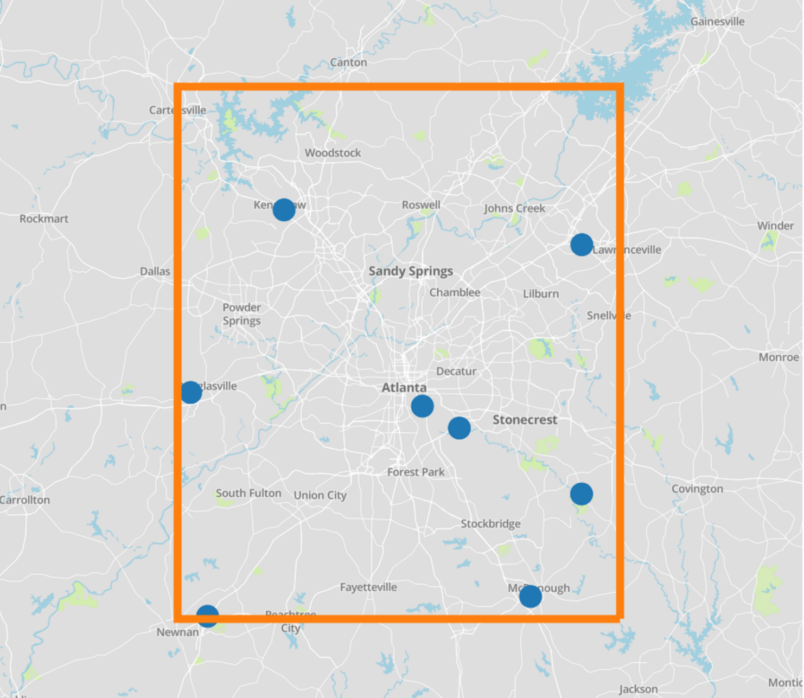
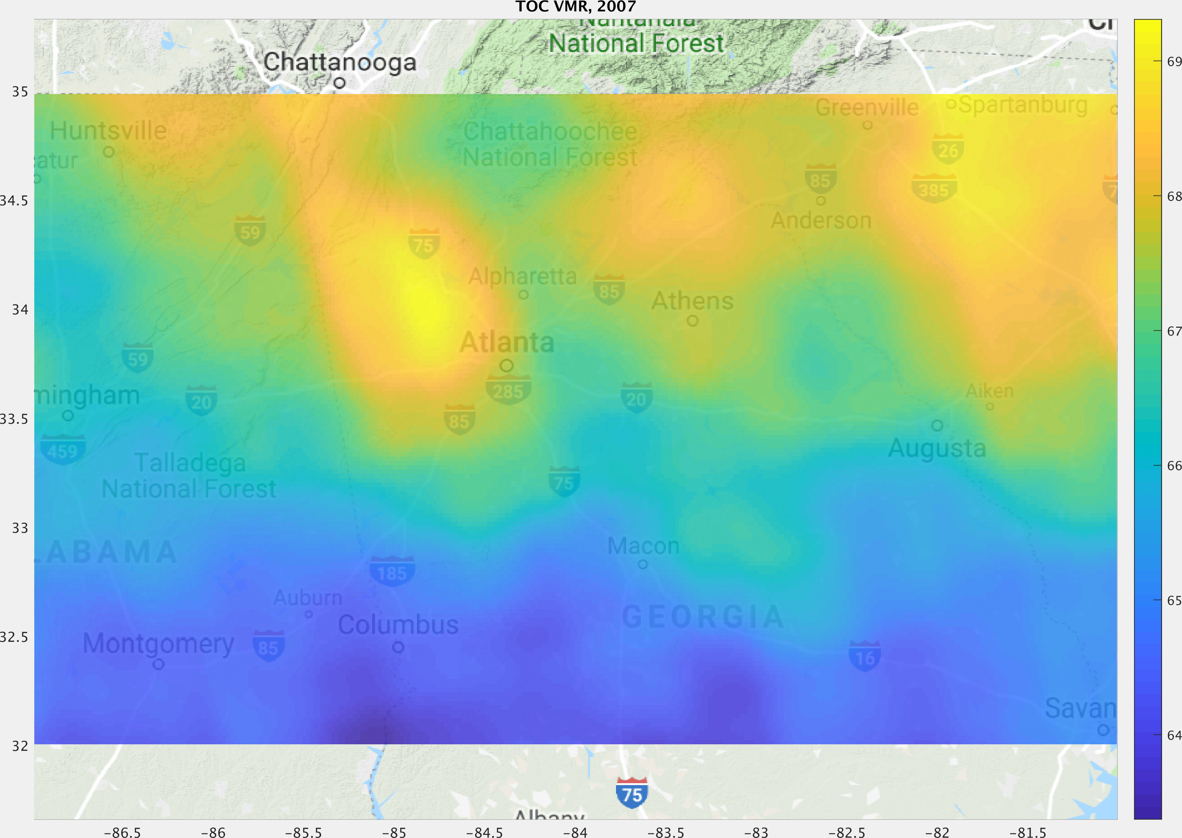
Study area - Atlanta GA
Atlanta GA, a major city in the Southeastern U.S.
“Hotlanta”, high temperature with high humidity in summer.
High vegetation coverage and large traffic volume.
Spelman, an HBCU, is building an TEMPO ozone garden.
Some in situ AQ monitors and a pollen monitor.
A Pandora and Doppler wind lidar (pending)
Spelman College
2007 Trop. Ozone by OMI and over-sampling method (Sun et al., 2018)

Slide 5
Data
March – October 2010.
1-hour ground ozone values from EPA ground stations (Blue Dots).
NASA MERRA-2 reanalysis (0.5° × 0.635°, hourly)
~80 km
~80 km

Slide 6
Satellite Data – OMI
Ozone Monitoring Instrument (OMI) is a nadir-viewing push-broom UV-visible instrument aboard the NASA Aura satellite, launched in July 2004.
Ozone profiles retrieved by Smithsonian Astrophysical Observatory (SAO) based on optical estimation algorithm.
OMI has some sensitivities in the lower troposphere (Huang et al., 2017)
Resolution: 52 km by 48 km at nadir
Overpass time: ~ 1:45pm local time
(Huang et al., 2017 and 2018, Liu et al., 2005 and 2010 )

Slide 7
Training dataset and Random Forest
Met data at 1:45pm (mean of 1pm and 2pm)
Wind speed at 2m and 850 hPa
Temperature at 2m and 850 hPa
Dew point temperature at 2m
Specific humidity at 2m and 850 hPa
Surface pressure and boundary layer top pressure
Sat. Obs.
Tropospheric ozone column
Lowermost ozone column (sfc. - 2.5~3km)
Cloud fraction
1:45pm sfc. Ozone (mean sfc. ozone at 1pm and 2pm)
All data are interpolated into our domain with 4 × 4 km grids.
Random Forest (Scikit-learn, python)

Slide 8
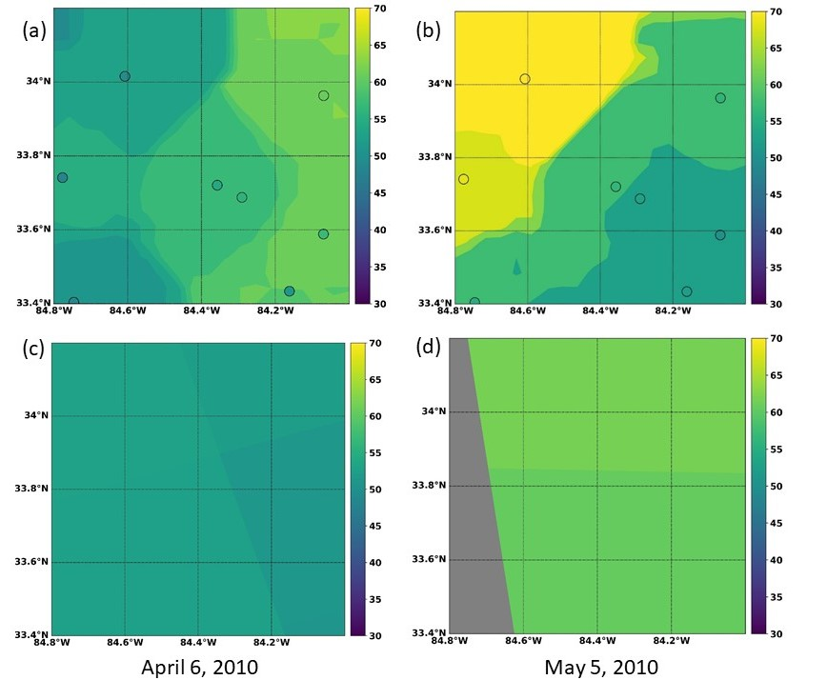
April 3, 2010
May 5, 2010
Improved OMI PBL ozone “obs.”
ppb
Original OMI ozone obs. at bottom layer
ppb

Slide 9
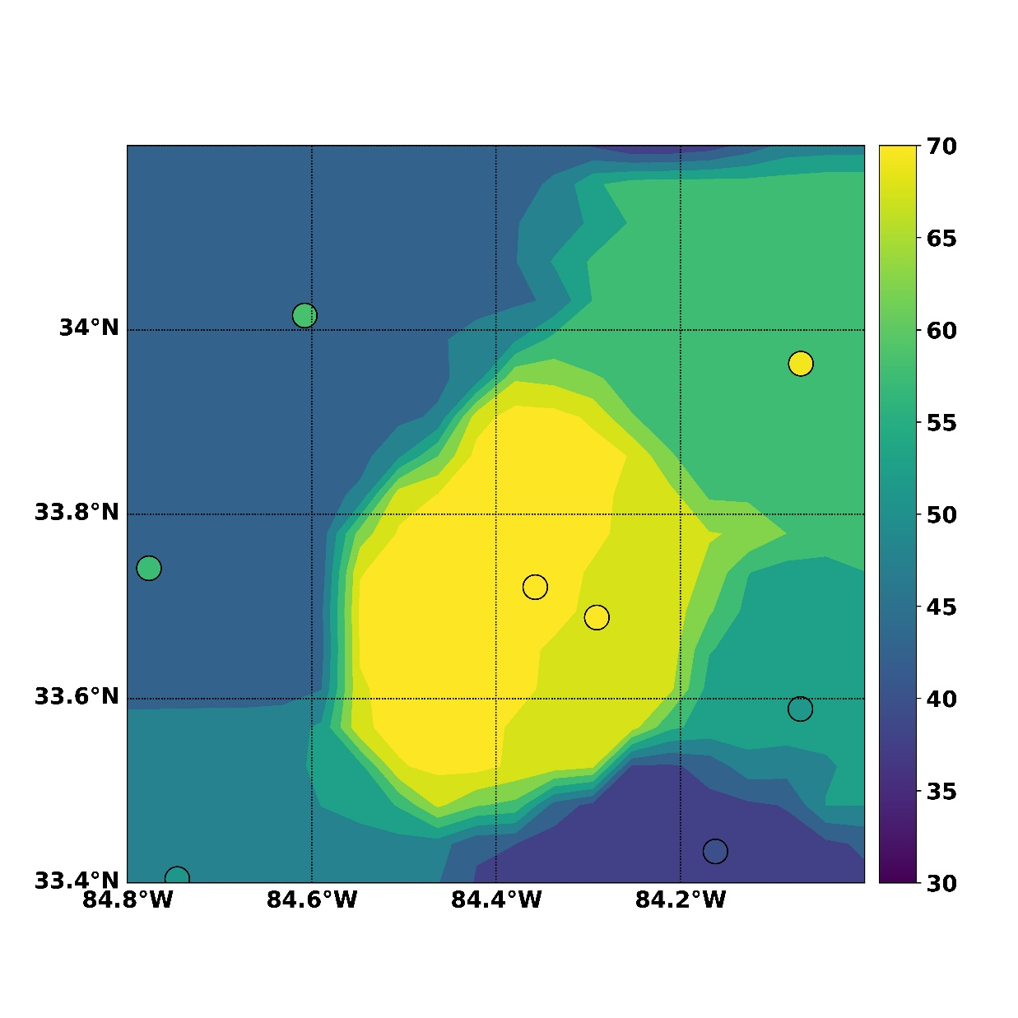
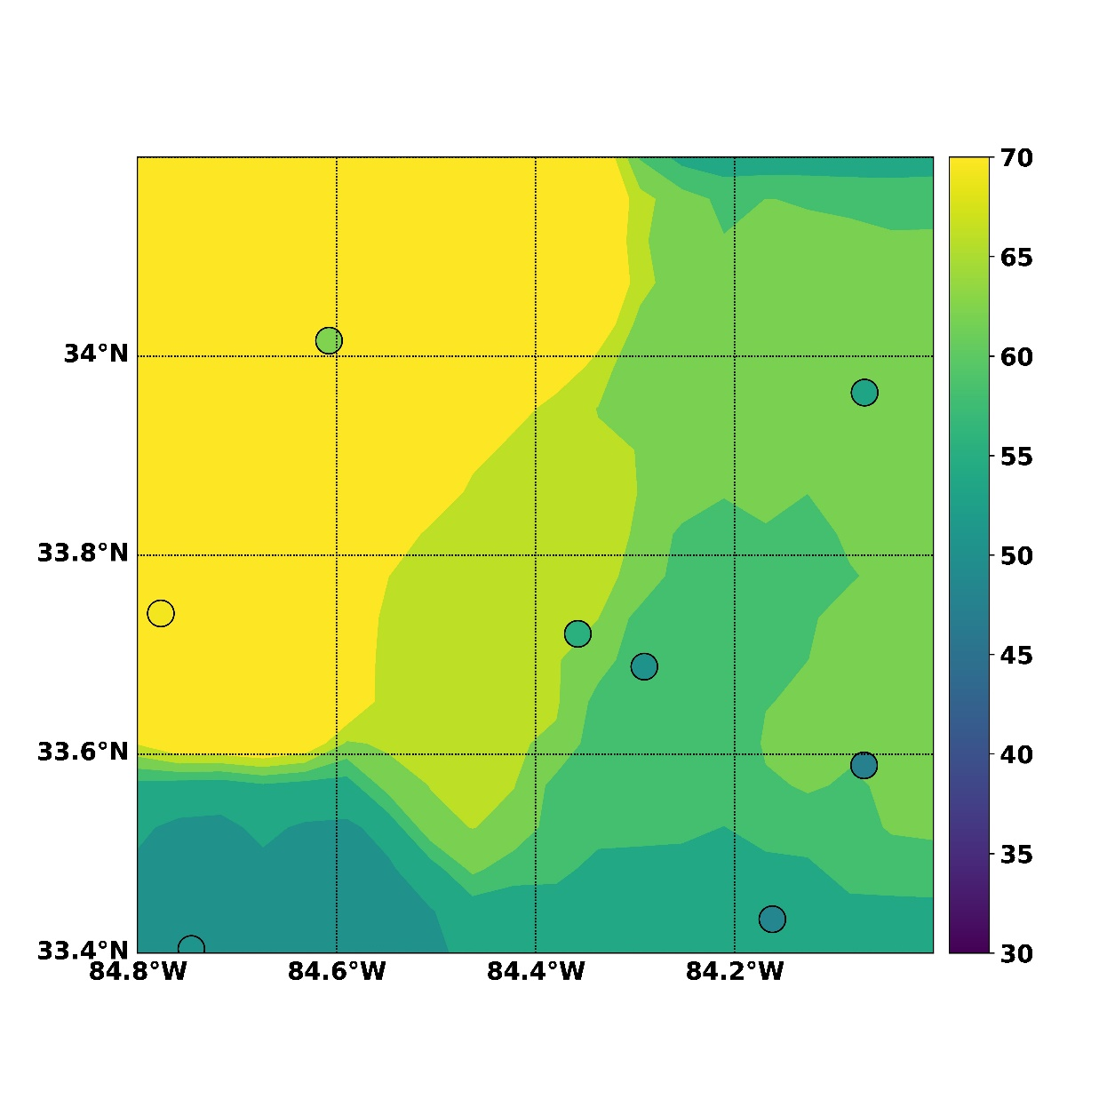
Jul. 26, 2010
Aug. 9, 2010

Slide 10
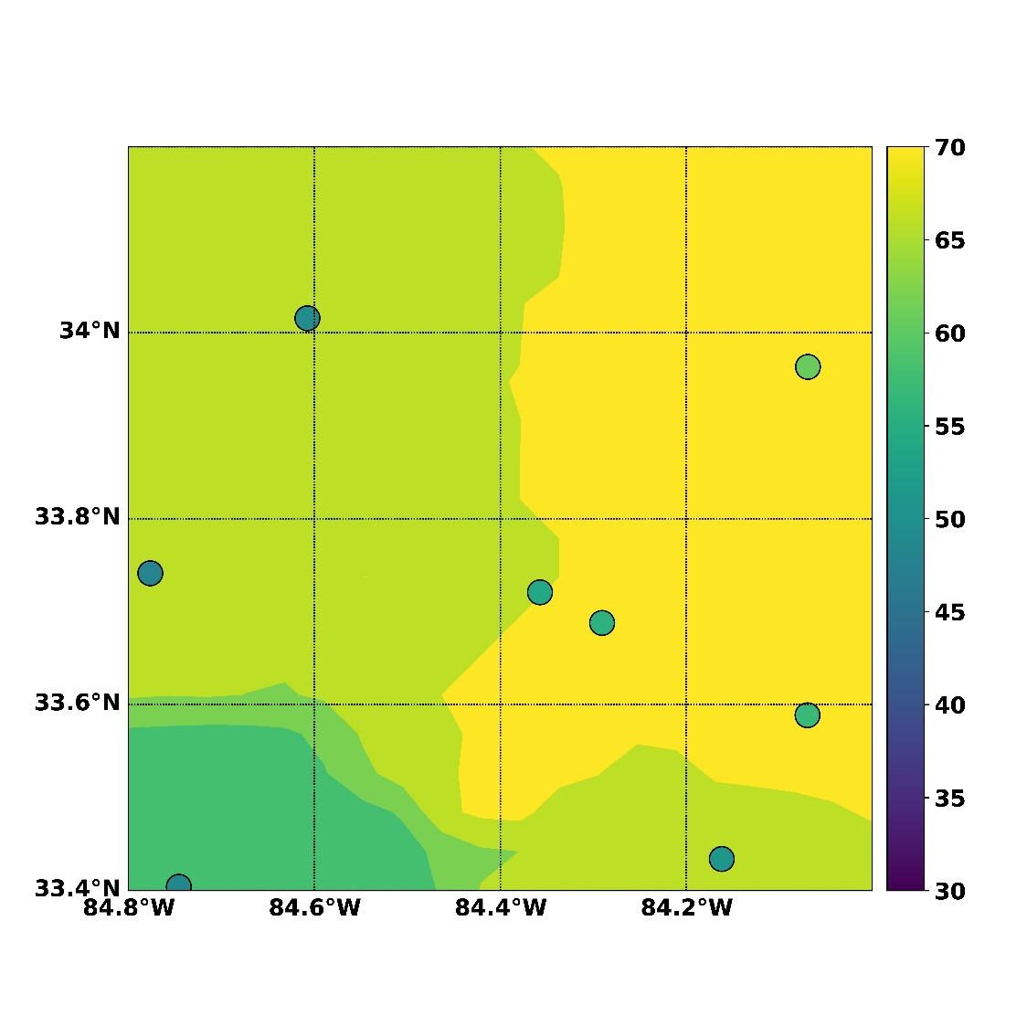
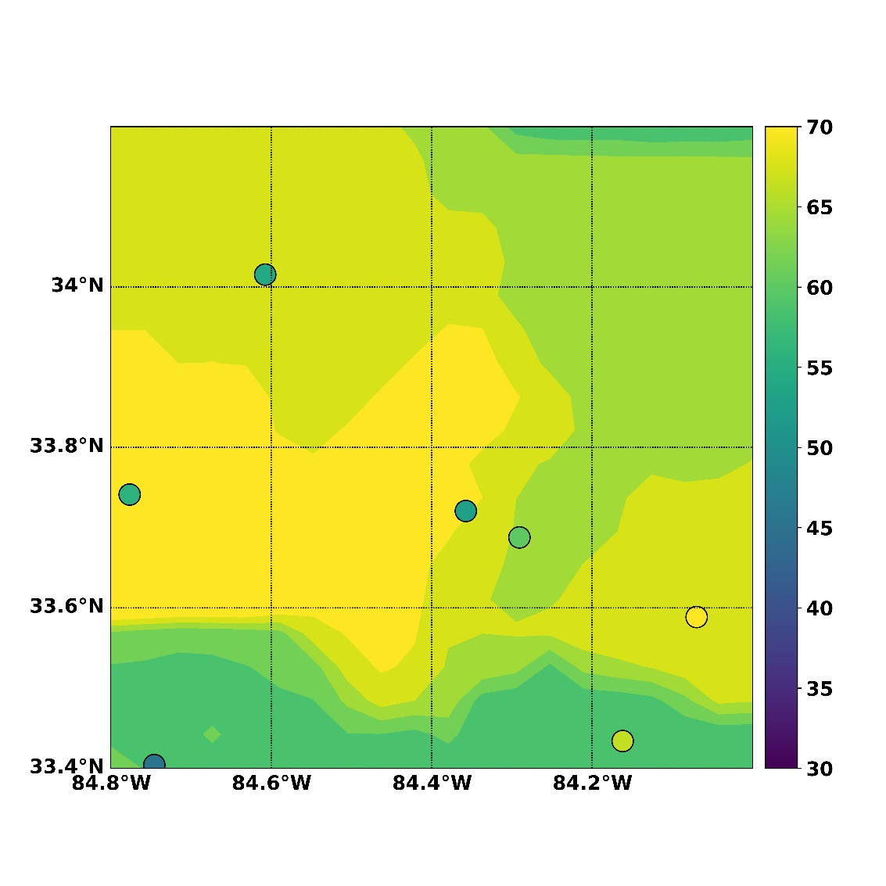
“Bad results”
Apr. 2, 2010
Sep. 18, 2010

Slide 11
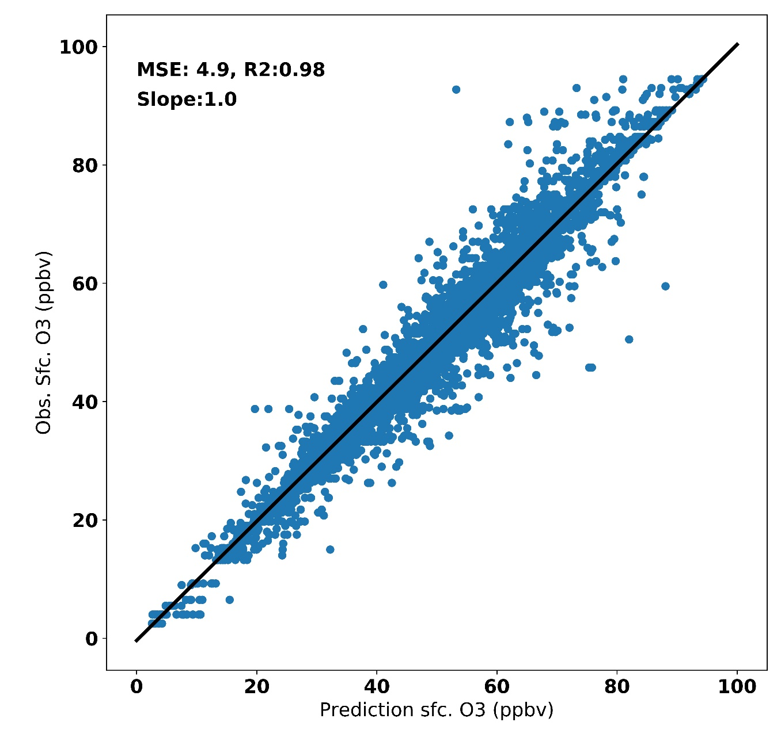
Results
Machine learning model did a good job on estimating ground ozone in Atlanta GA, MSE 4.9 and R² 0.98
EPA Ground Obs. (ppb)
Improved OMI Obs. (ppb)

Slide 12
Summary
The retrieval of PBL-level ozone is significantly improved by using machine learning.
We anticipate the accuracy of PBL-level ozone can be improved after adding more data (ozone precursors, land cover, etc.)
Physical explanations are under investigation.
Dense surface measurements are critical for training our models.
We are testing more machine learning models over different regions.

Slide 13
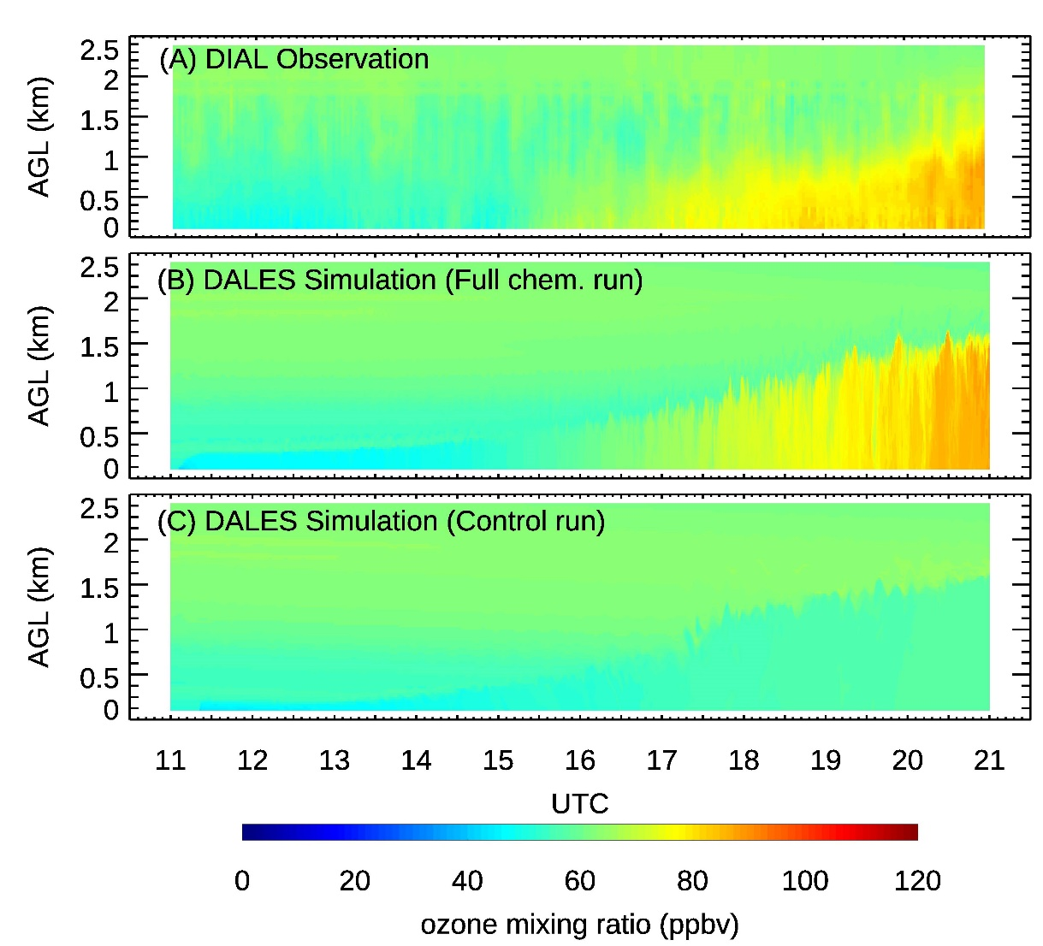
Implications for TEMPO
A case study of PBL ozone, 9/6/2013, Huntsville AL
PBL-level ozone retrievals with high accuracy and resolution.
Hourly PBL-level ozone retrievals.
The retrieval of PBL ozone can be challenging at transition time when the PBL structure is complicated.
Ozone profile info is needed.
Lidar Obs.
Large-Eddy Simulation with Chem
Large-Eddy Simulation with no Chem
ghuang@spelman.edu
(Huang et al., 2019)

Slide 14
Thanks

Slide 15
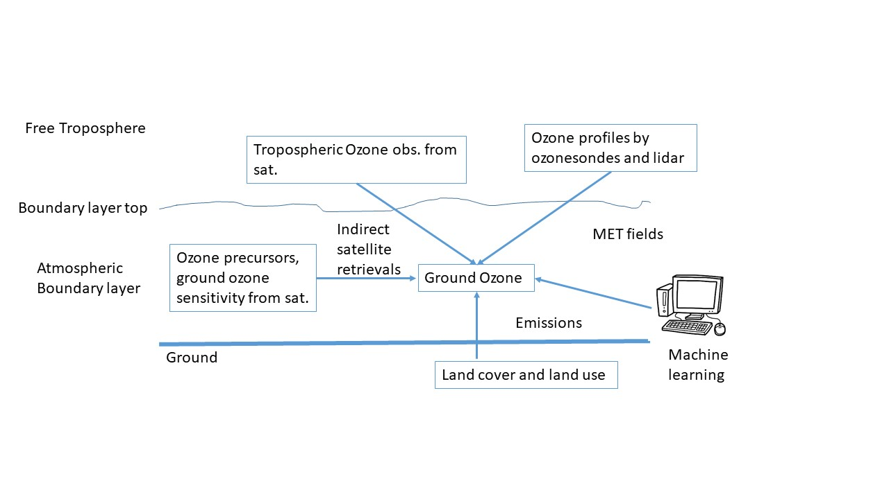
Hypothesis
Our ozone retrieval algorithm on PBL ozone can be improved by machine learning technique and data below
Sat. sensitivities on the ground ozone
Ozone precursors’ observations from Sat. (in progress)
MET including boundary layer
Machine learning models
Land cover and emissions (e.g. fires) (in progress).

